Slide 1

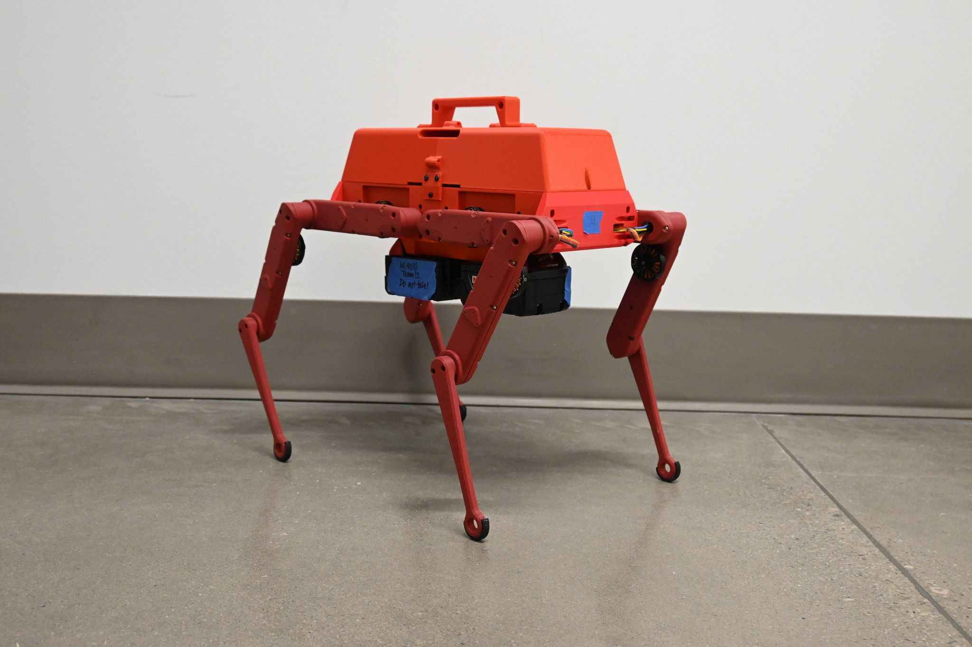
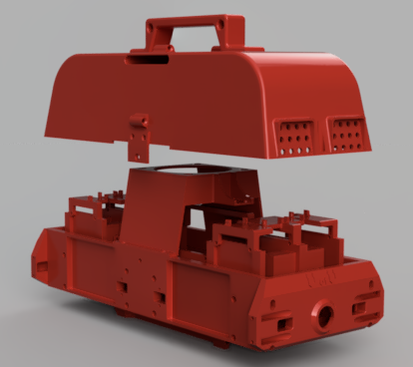
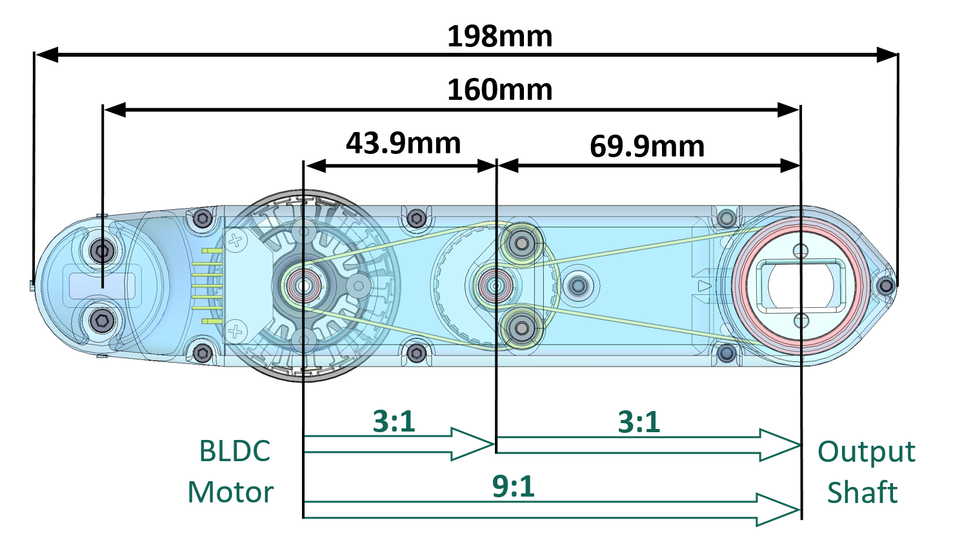
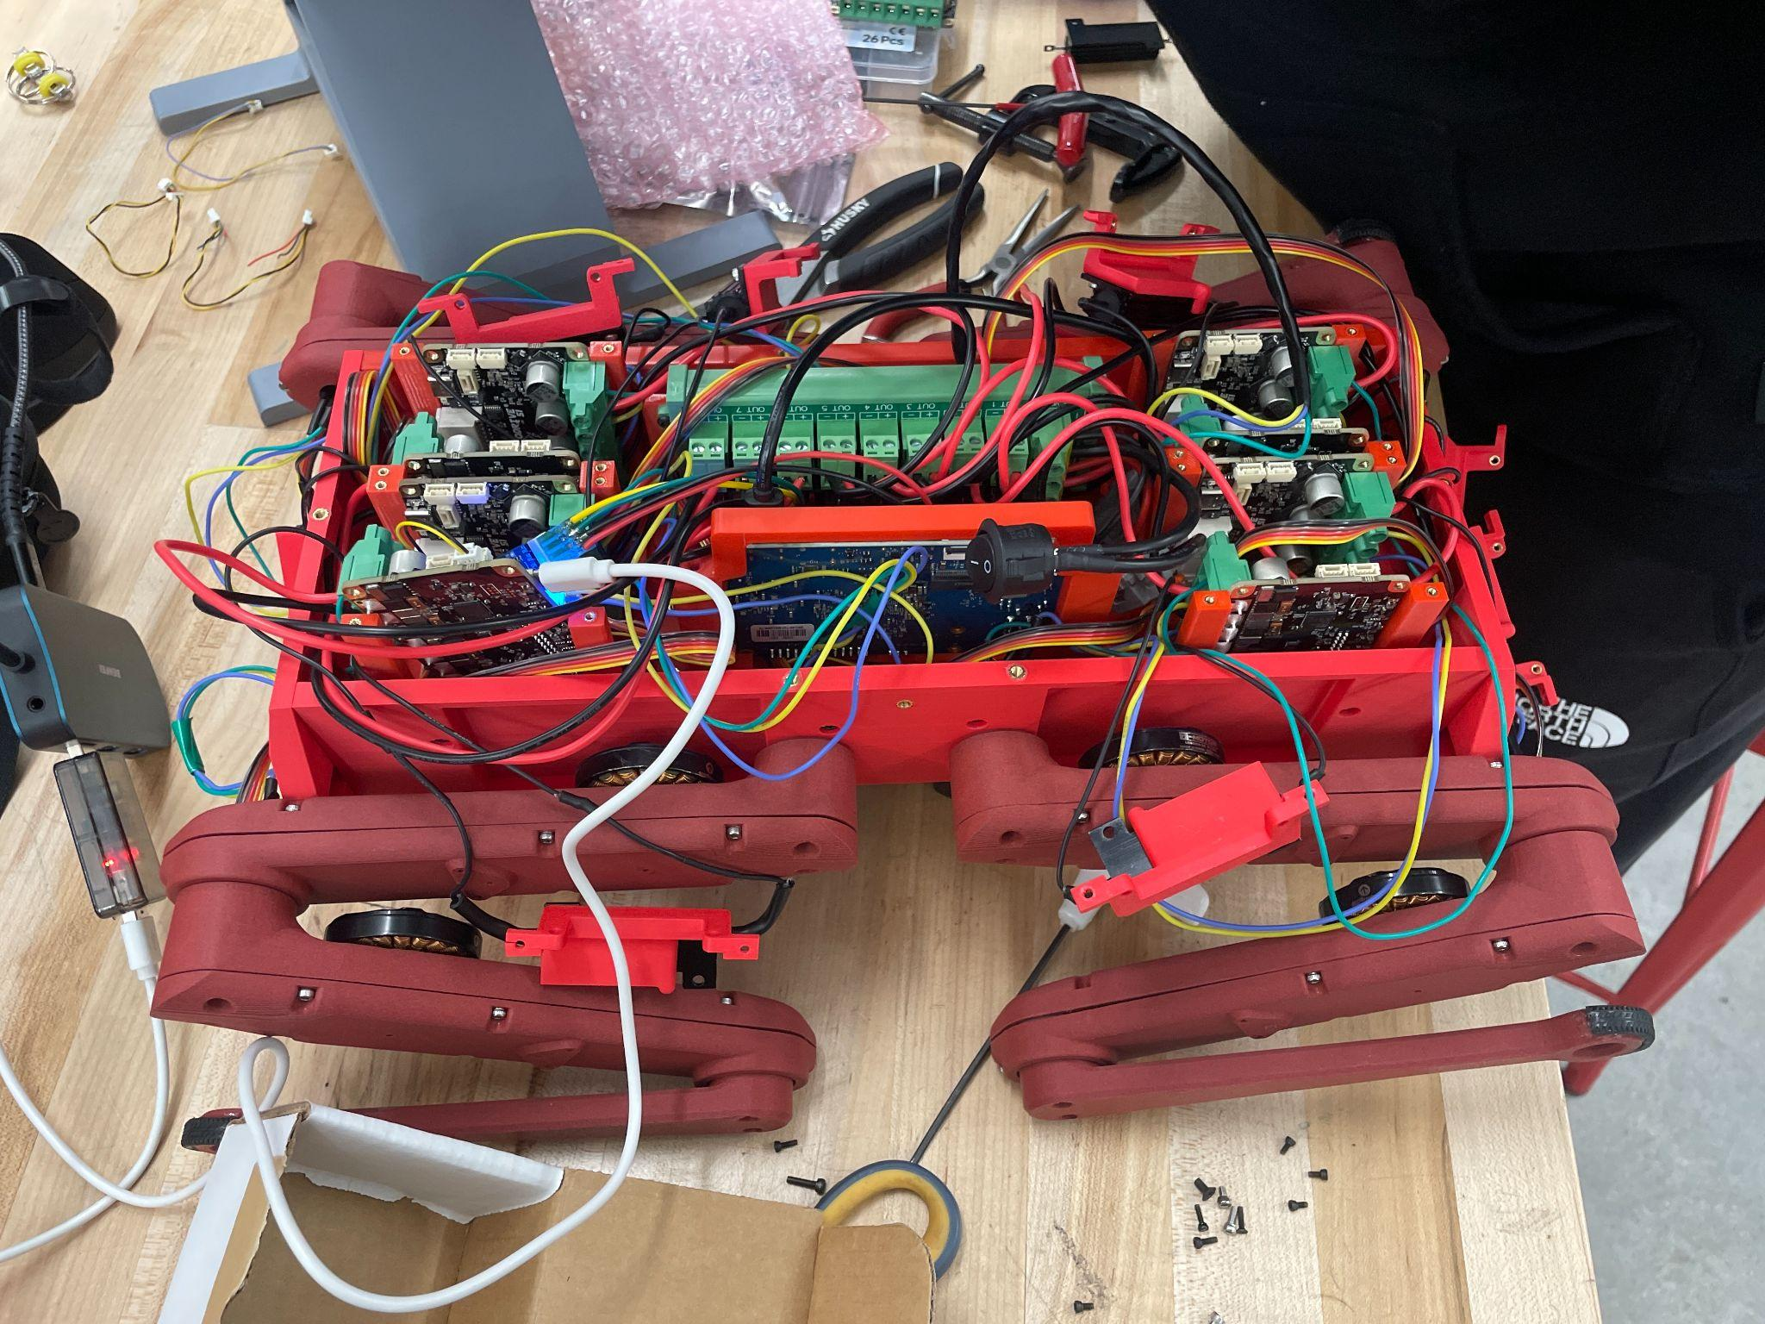
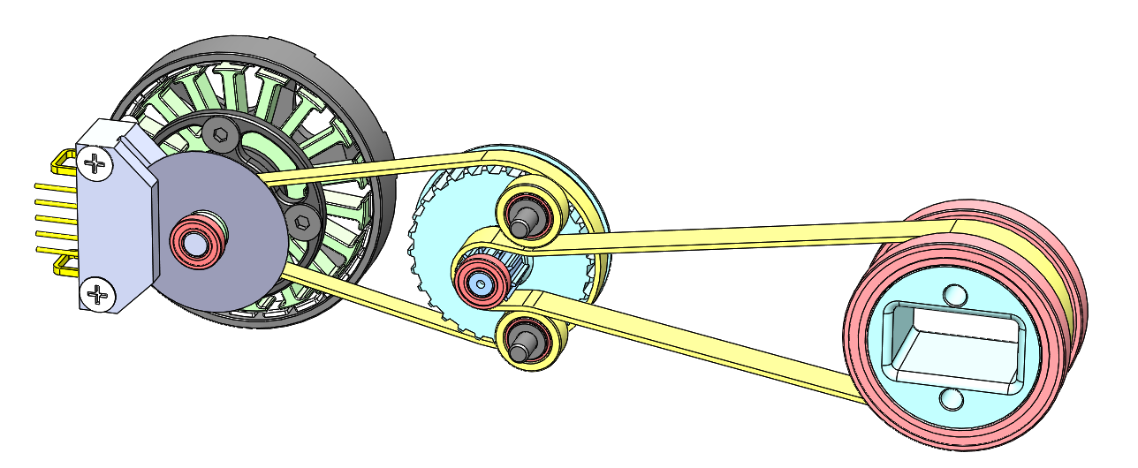
Quadruped Robot for Smart Agriculture
Austin Neff, Kevin Nelson, Jordan Raver, Ben Siesser, Sam Spencer, Yang Yang
Advisors: Dr. Shad Roundy, Dr. Kam Leang
Introduction
The Quadruped Robot for Agricultural Research is a wireless eight degree of freedom four-legged robot. Its purpose is to serve as a rugged, portable, and upgradable base for future robotics and agricultural research. The design follows the open-source Open Dynamic Robot Initiative (ODRI) for its actuators, reworks the body to enable full autonomy and increase affordability, but sticks to open hardware and software to maintain upgradability.
Leg Actuator Module
The ODRI leg modules use T-Motor MN4004 KV300 brushless motors with a peak power output of 216 W. The modules include a 10:1 ratio belt system to increase the torque. The motors make use of ODRI’s custom 5000 count-per-rotation indexed optical encoder wheels to allow for control to 1/50000th of a joint rotation with the ability to change directions. Two modules are used for each leg for planar end-effector control. The legs were printed in CF-PLA for strength and improved finish.
Body
The body was 3D printed out of PLA filament. The ODrive boards are mounted vertically to allow four boards to fit on each end of the body. Two battery mounting points are added on the bottom of the robot for untethered power delivery. A lid is added to seal and waterproof the internal systems, as well as add a handle for easy carrying, with an 80mm fan attached to prevent the electronic components from overheating.
Figure 2: CAD Rendering of 3D Printed Parts
Results
The final performance values of the robot are summarized in Table 1. The leg torque desired value is the given value from the ODRI project, while the final value is what we measured. The robot weight limit is derived from the expected torque output of the legs. We were able to achieve most of these specifications as well as basic walking motion. However, due to limitations with the 8 degree of freedom platform, we were unable to achieve a full range of motion. Further, while we were unable to meet the target current draw, which was derived from the peak draw of all motors simultaneously, during testing no motor has exceeded 7 amps, and the most they attempt to draw simultaneously is 12 amps total.
Figure 1: ODRI 10:1 belt system assembly (left) and actuator module shell (right)
Motor Control
The ODRI design was changed to control T-Motor MN4004 KV300 motors using the ODrive S1 motor controllers. The ODrives are controlled via CAN bus by an Orange Pi 5 running Ubuntu 22.04. The Robot Operating System 2 (ROS2) Humble Hawksbill is used by the Orange Pi 5 to manage the logic and controls of the quadruped robot, which are all commanded wirelessly by SSH.
Power System
The system runs off of a Milwaukee 18V XC5.0 battery to reach a 34 minute run time. The choice to use Milwaukee batteries was made for easy access and to use the built-in safety features included with the battery. 18V is used directly to power the motors through a 9-way power splitter with one line dedicated to a 18V to 5V buck down converter that powers the Orange Pi 5.
Figure 3: Internal wiring of robot
Conclusion
The Quadruped Robot for smart agriculture successfully demonstrates the ability to make basic movements (stand and sit). It is a fully open architecture which allows future research into robot control. To achieve field readiness (rugged walking capability) 12 degrees of freedom should be used as opposed to 8. This would allow the robot to perform a twisting action which would allow it to stabilize more effectively while stepping. Custom batteries would also need to be assembled to reduce weight. Alternatively, the actuator modules could be redesigned to increase torque output capabilities. Also, IMU input based walking algorithms still need to be developed for walking on uneven terrain.
Table 1. A collection of measured capabilities compared to desired metrics
Metric | Final Value | Desired Value
Single Leg Torque | 2.142 Nm | 2.1 Nm
Robot Weight | 9.75 lbs | 12.64 lbs
Battery Power Output | 18.7 V, 20 A | 18 V, 80 A
Robot Runtime | 34 minutes | 30 minutes

Slide 2

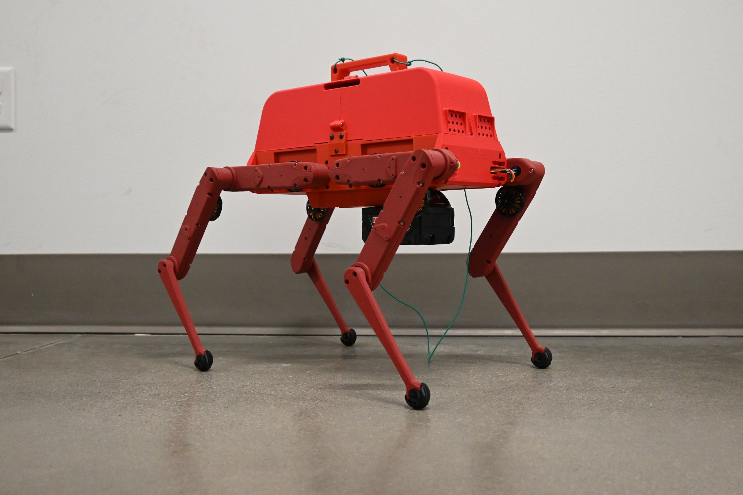
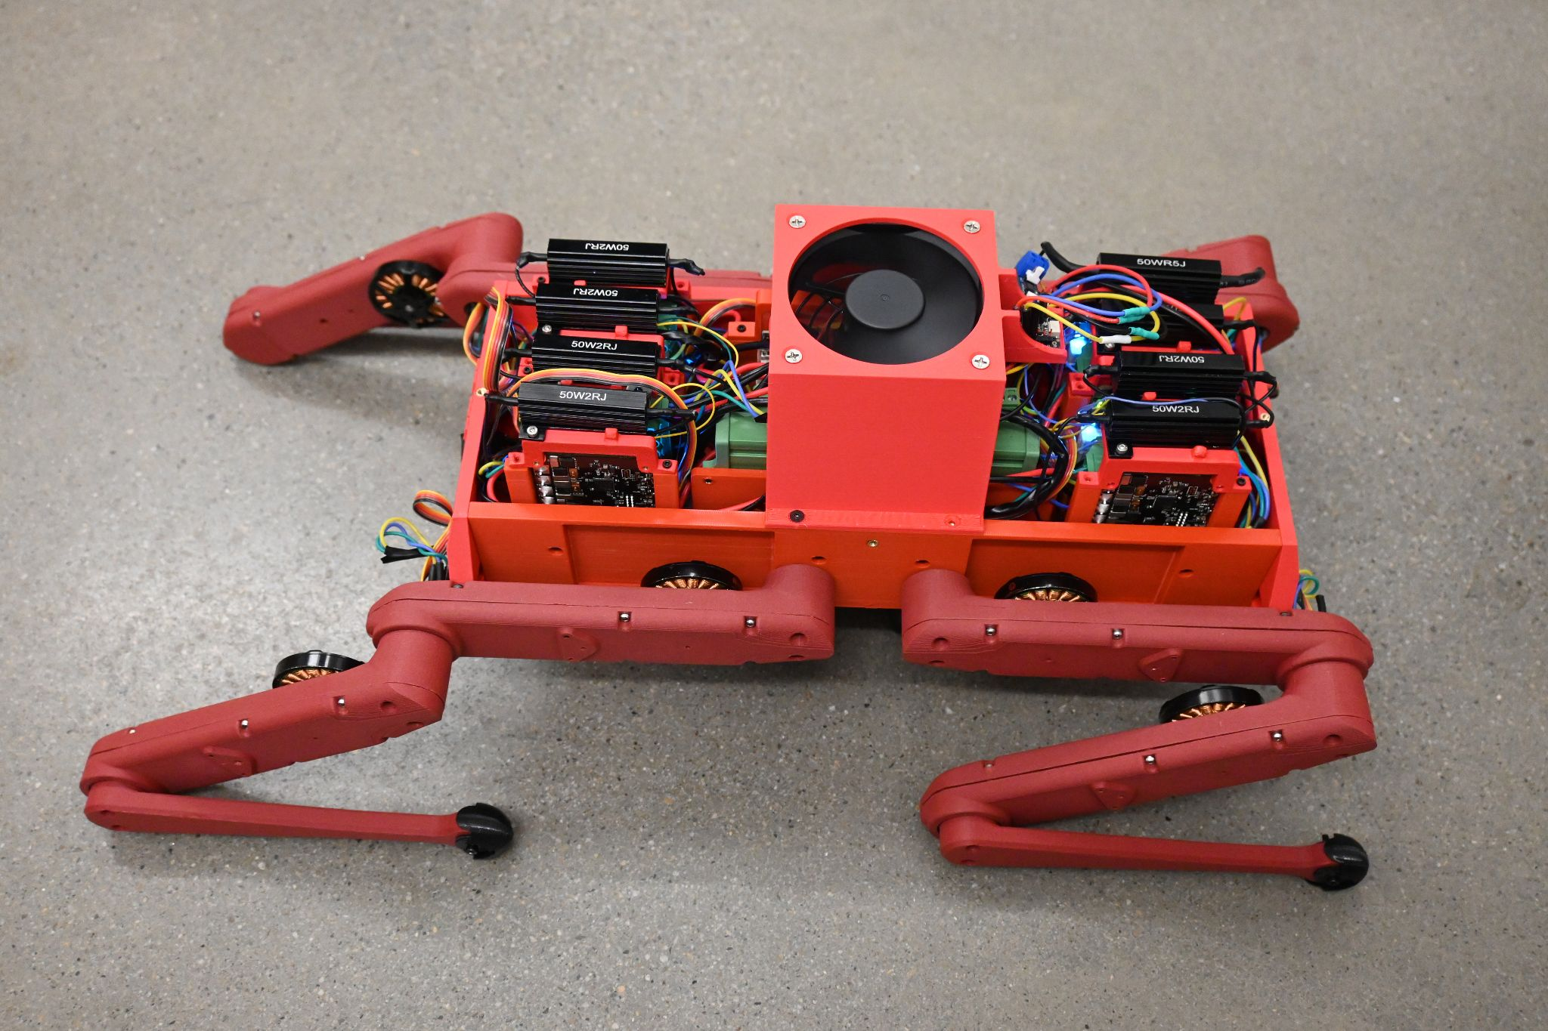
Quadruped Robot for Smart Agriculture
Austin Neff, Kevin Nelson, Jordan Raver, Ben Siesser, Sam Spencer, Yang Yang
Advisors: Dr. Shad Roundy, Dr. Kam Leang
Introduction
The Quadruped Robot for Agricultural Research is a wireless eight degree of freedom four-legged robot. Its purpose is to serve as an open and affordable alternative to other industrial quadrupeds–all other options are some combination of vastly overpriced or locked down and unmoddable. The design follows the open-source Open Dynamic Robot Initiative (ODRI) for its actuators, reworks the body to enable full autonomy and increase affordability, and sticks to open hardware and software to maintain upgradability.
Leg Actuator Module
The ODRI leg modules use T-Motor MN4004 KV300 brushless motors with a peak power output of 216 W. The modules include a 10:1 ratio belt system to increase the torque. The motors make use of ODRI’s custom 5000 count-per-rotation indexed optical encoder wheels to allow for control to 1/50000th of a joint rotation with the ability to change directions. Two modules are used for each leg for planar end-effector control. The legs were 3D-printed in Carbon Fiber PLA (CF-PLA) for strength and improved finish.
Motor Control
The ODRI design was changed to control T-Motor MN4004 KV300 motors using the ODrive S1 motor controllers. The ODrives are controlled via CAN bus by an Orange Pi 5 running Ubuntu 22.04. The Robot Operating System 2 (ROS2) Humble Hawksbill is used by the Orange Pi 5 to manage the logic and controls of the quadruped robot, which are all commanded wirelessly by SSH.
Power System
The system runs off of a Milwaukee 18V XC5.0 battery to reach a 34 minute run time. The choice to use Milwaukee batteries was made for easy access and to use the built-in safety features included with the battery. 18V is used directly to power the motors through a 9-way power splitter with one line to a 18V to 5V buck down converter that powers the Orange Pi 5, and the remaining eight lines connecting to the motor drivers.
Results
The final performance values of the robot are summarized in Table 1. The leg torque desired value is the given value from the ODRI project, while the final value is what we measured. The robot weight limit is derived from the expected torque output of the legs. We were able to achieve most of these specifications as well as basic walking motion. However, due to limitations with the 8 degree of freedom platform, we were unable to achieve a full range of motion. Further, while we were unable to meet the target current draw, which was derived from the peak draw of all motors simultaneously, during testing no motor has exceeded 7 amps, and the most they attempt to draw simultaneously is 18 amps total.
Table 1. A collection of measured capabilities compared to desired metrics
Metric | Final Value | Desired Value
Single Leg Torque | 2.142 Nm | >2.1 Nm
Robot Weight | 9.75 lbs | <12.64 lbs
Battery Power Output | 18.7 V, 20 A | 18 V, >80 A
Robot Runtime | 34 minutes | >30 minutes
Body
The body was 3D printed out of PLA filament. The ODrive boards are mounted vertically to allow four boards to fit on each end of the body. Two battery mounting points are added on the bottom of the robot for untethered power delivery. A lid is added to seal and weather-proof the internal systems, as well as add a handle for easy carrying, with an 80mm fan attached to a bracket in the center to prevent the electronic components from overheating.
Figure 1: ODRI 10:1 belt system assembly (left) and actuator module shell (right)
Figure 3: Internal wiring of robot
Conclusion
The Quadruped Robot for smart agriculture successfully demonstrates the ability to make basic movements (stand and sit). It is a fully open architecture which allows future research into robot control. To achieve field readiness (rugged walking capability) 12 degrees of freedom should be used as opposed to 8. This would allow the robot to perform a twisting action which would allow it to stabilize more effectively while stepping in addition to enabling turning. Custom batteries would also need to be assembled to reduce weight. Alternatively, the actuator modules could be redesigned to increase torque output capabilities and consistency.
Figure 2: CAD Rendering of 3D Printed Parts

Slide 3
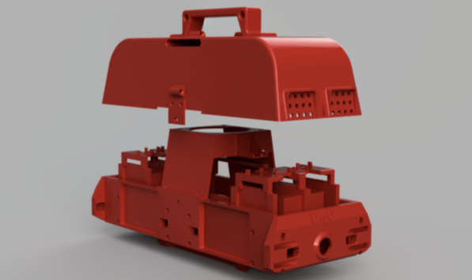
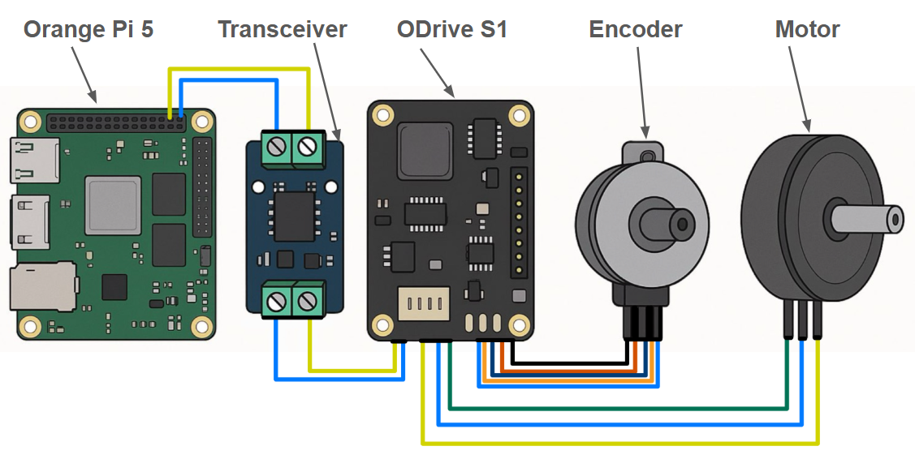
Quadruped Robot for Smart Agriculture
Austin Neff, Kevin Nelson, Jordan Raver, Ben Siesser, Sam Spencer, Yang Yang
Advisors: Dr. Shad Roundy, Dr. Kam Leang
Introduction
The Quadruped Robot for Smart Agriculture is a wireless, eight degree of freedom, four-legged robot. Its purpose is to serve as an open source alternative to other industrial quadrupeds which do not allow access or modification to low level control. This design uses the open-source Open Dynamic Robot Initiative (ODRI) as a starting point. The ODRI actuator module design was integrated with a fully accessible motor control system, power system, and body to create an accessible research platform without manufacturer restrictions.
Leg Actuator Module
The ODRI leg modules use T-Motor MN4004 KV300 brushless motors with a peak power output of 216 W. The modules include a 9:1 ratio belt system to achieve 2.1 Nm of torque, for a body weight limit of 12.6 pounds. 5000 count-per-rotation indexed optical encoder wheels are used to track joint angles. The legs were 3D-printed in Carbon Fiber PLA (CF-PLA) for added strength.
Motor Control
The Orange Pi 5 was selected as the central controller. It runs Robot Operating System 2 (ROS2) Humble Hawksbill, an open source robot control system, on Ubuntu 22.04. It supports a CAN bus via transceiver. ODrive S1 motor controllers combine three phase brushless motors with an encoder to achieve closed loop servo control. The ODrive S1 was chosen for it’s high current rating, open architecture, and CAN bus daisy chain support allowing integration with both the motors and the Orange Pi.
Results
The final performance values of the robot are shown in Table 1. The leg torque desired value is the given value from the ODRI project, while the final value is what we measured. We were able to achieve most of these specifications as well as basic walking motion. However, due to limitations with the 8 degree of freedom platform, we were unable to achieve a full range of motion. Further, while we were unable to meet the target current draw, which was derived from the peak draw of all motors simultaneously, during testing no motor exceeded 7 amps. The most all the motors attempt to draw simultaneously was 18 amps total. Runtime was tested under a static load.
Table 1: A collection of measured capabilities compared to desired metrics
Metric | Final Value | Desired Value
Single Leg Torque | 2.142 Nm | >2.1 Nm
Robot Weight | 9.75 lbs | <12.64 lbs
Battery Power Output | 18.7 V, 20 A | 18 V, >80 A
Robot Runtime | 42 minutes | >30 minutes
Basic Walking | Tethered | Untethered
Rough Terrain Walking | Unsuccessful | Untethered
Figure 2: Robot standing using battery power.
Body
The body is fully 3D printable. The ODrive boards are mounted vertically allowing four boards to fit on each end of the body. For untethered power delivery, two battery mounts–to reduce weight only one is used–were added on the bottom of the robot. A lid was added to protect internal systems, with an 80mm cooling fan attached in the center.
Figure 1: ODRI 9:1 belt system assembly (left) and actuator module shell (right)
Figure 4: Internal wiring of robot
Conclusion
The Quadruped Robot for Smart Agriculture successfully demonstrates the ability to make basic movements (stand and sit). It is a fully open architecture which allows future research into robot control. To achieve field readiness (rough terrain walking capability) 12 degrees of freedom should be used as opposed to 8. This would allow the robot to perform a twisting action which would allow it to stabilize more effectively while stepping in addition to enabling turning. Custom batteries would also need to be assembled to reduce weight. Alternatively, the actuator modules could be redesigned to increase torque output capabilities and consistency.
Figure 3: CAD Rendering of 3D Printed Parts
Power System
The system runs off of a Milwaukee 18V XC5.0 battery to reach a 42* minute run time. The choice to use Milwaukee batteries was made for easy access and to use the built-in safety features included with the battery.
Figure 2: Single Motor Control Setup Using ODrive

Slide 4
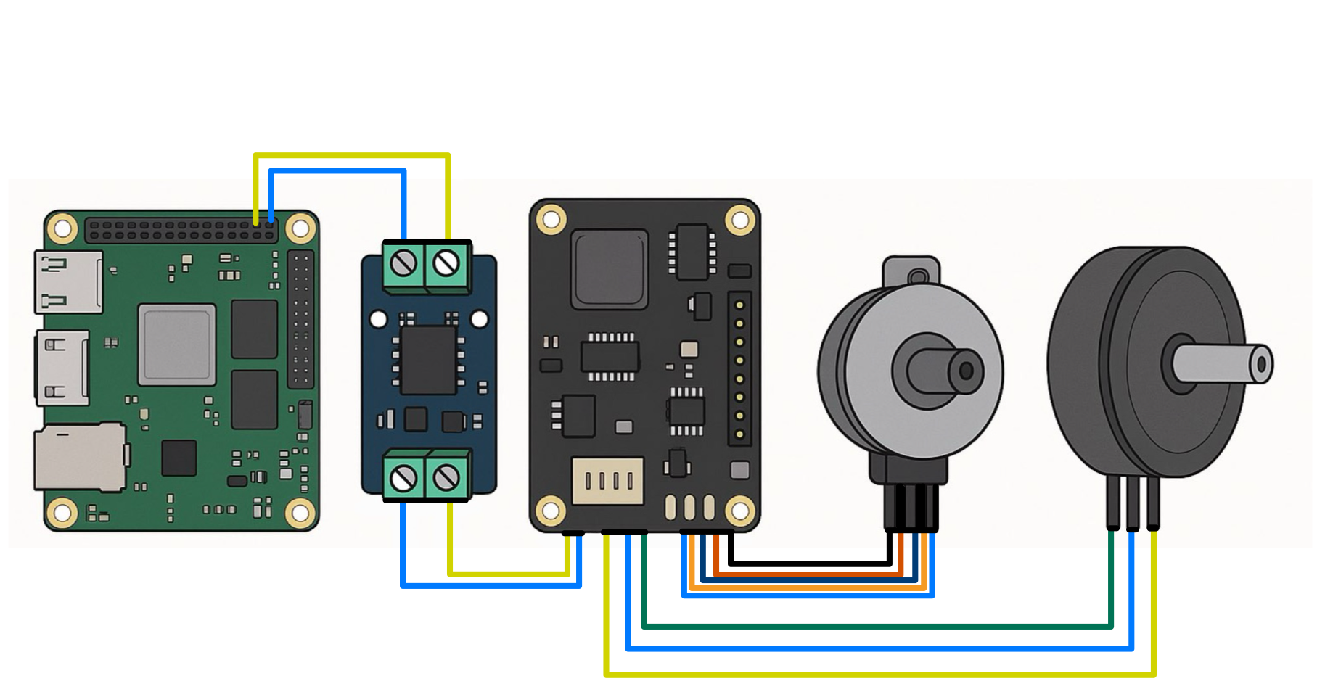
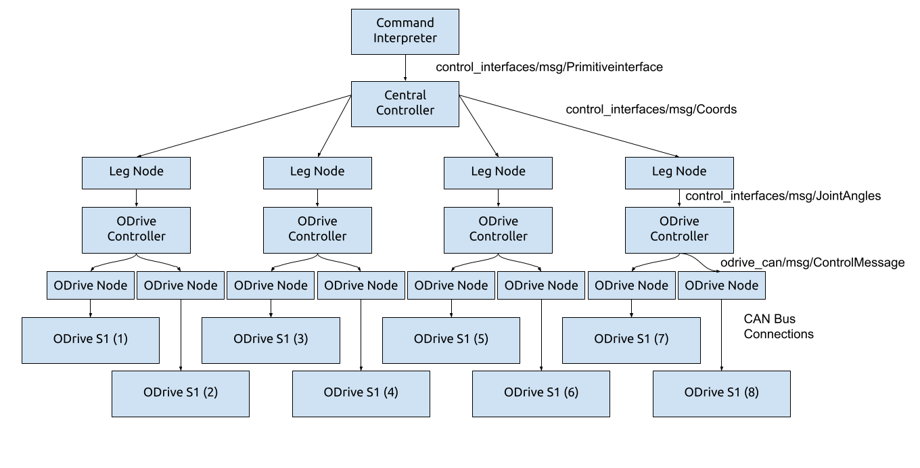
Orange Pi 5
Transceiver
ODrive S1
Encoder
Motor

